Slide 1
Predicting colon cancer via deep learning
Joseph Waugh

Slide 2
project Outline
Project Goals and Requirements
Team Roles & Contributions
Research Based on Industry Problem
Research Based on Gaps in Domain
Demonstration of Application
Project Status & Gantt Chart
Discussion of Future Plans and Opportunities

Slide 3
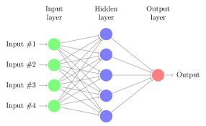
Project Goals & Requirements
Goals:
Create a neural network (NN) model which output a percentage likelihood whether the user has colorectal cancer
Deploy the NN model via a Flask web application which allows a user to upload images of their CT scans, and receive feedback regarding their own scan
Requirements:
Gain an understanding of the TensorFlow and Keras Python
Secure a dataset to train our cancer-detecting model
Deploy the web application via Heroku

Slide 4

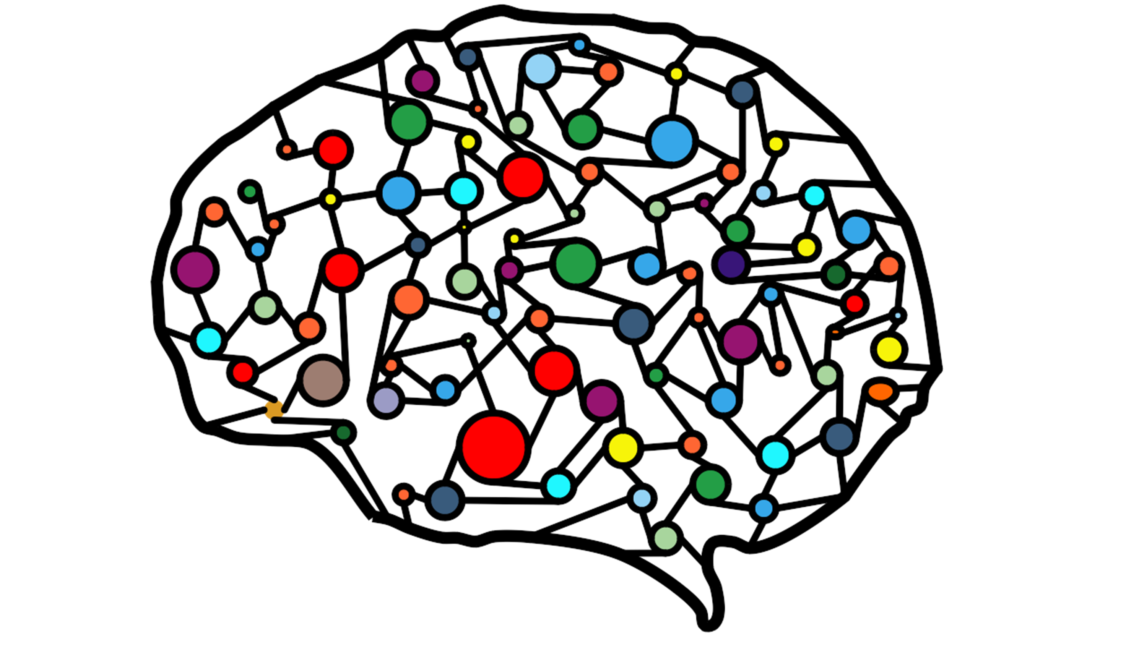



Team Roles & Contributions
Project Number: Project #25 – Early Colon Cancer Detection in Men
This project was listed as an individual project (and was completed individually), thus the following activities were completed individually:
Idea Generation
Data Collection
Model Development, Documentation & Deployment
Web Application Creation

Slide 5
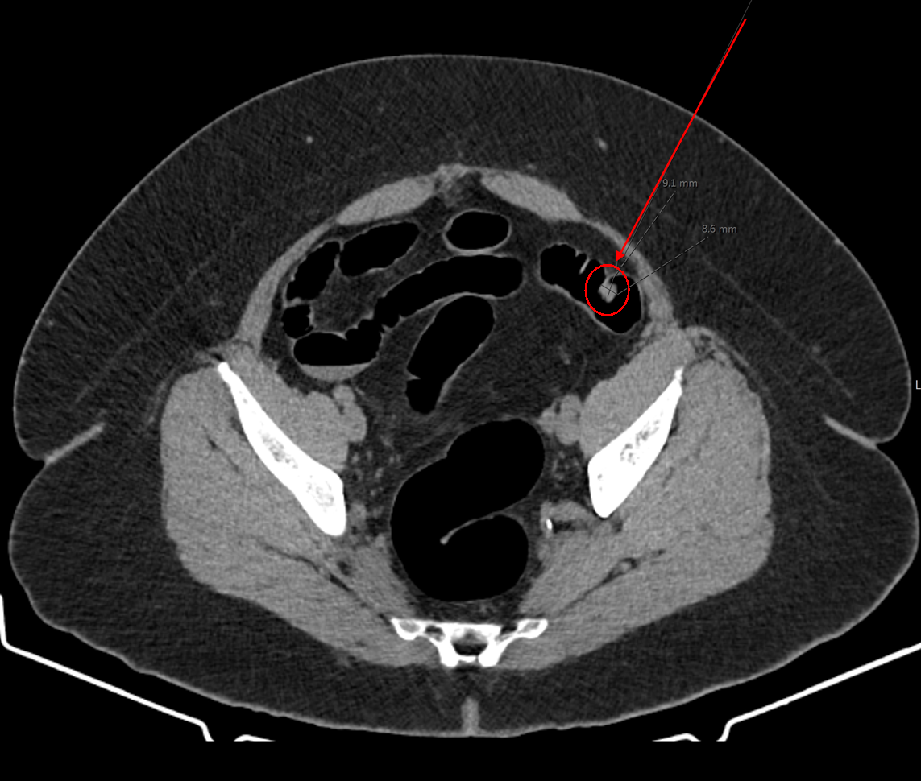

Research Based on Industry Problem
The following topics were researched to better understand the colon cancer prevalence among men:
Medical Imaging Standards (DICOM, CT Colonographies, Endoscopic Images)
Availability of CT scan data (Kvasir Dataset*, The Cancer Imaging Archive)
Opportunities with early cancer detection
*The Kvasir dataset was created using endoscopic imaging in the GI tract, where classes of “polyps” and “normal-cecum” were identified based on 500 cancerous and 500 non-cancerous images

Slide 6
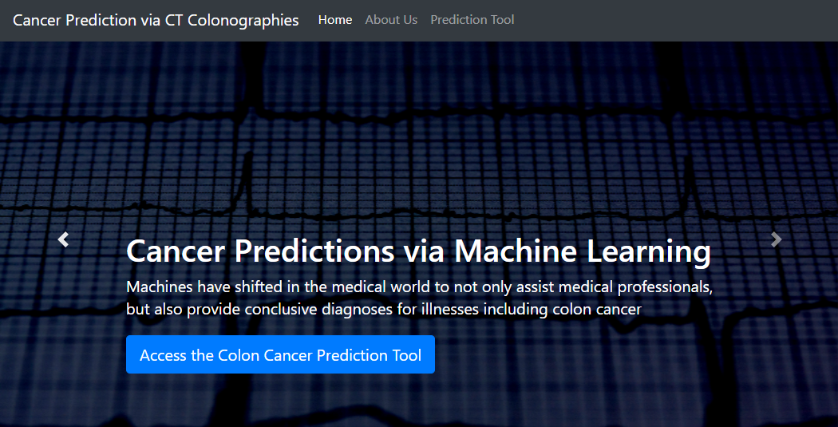


Research Based on gaps in domain
Given this topic is new based on the group’s skillsets, the following topics required research:
Neural Networks (i.e., TensorFlow & Keras Libraries)
Heroku App Deployment (via Python Framework)

Slide 7
Research
This project required additional research in the following areas to support the project development:
Neural Networks (i.e., TensorFlow & Keras Libraries)
DICOM Imaging in Deep Learning Models
Heroku App Deployment (via Python Framework)

Slide 8
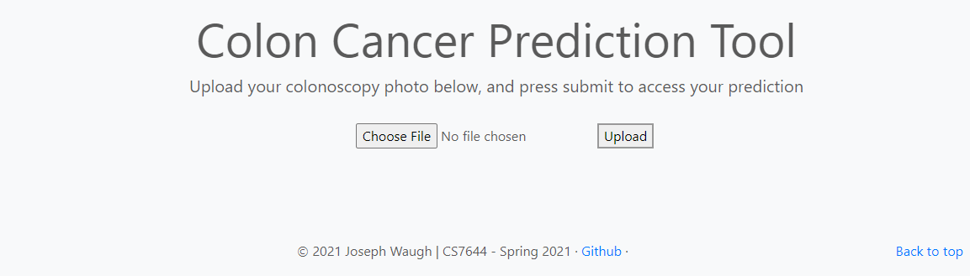
Demonstration of application
Polyp Predictor Application Link
Webpage Screenshot Page:

Slide 9
Project status/gantt chart

Slide 10
Future plans and opportunities
To improve the model’s scope, additional data can be used to train the CNN model
The model used the first of three versions of the Kvasir dataset*
Additional classifiers for the polyp detection can be used to identify cancerous cells, normal cells, inflammatory diseases (i.e., esophagitis, ulcerative colitis, etc.)
*The Kvasir dataset contains three versions. For this research, version 1 was used (~1.2 GB), whereas the V2 (~2.3 GB) and V2.1 (~25.3 GB) are also available for public use

